Slide 1
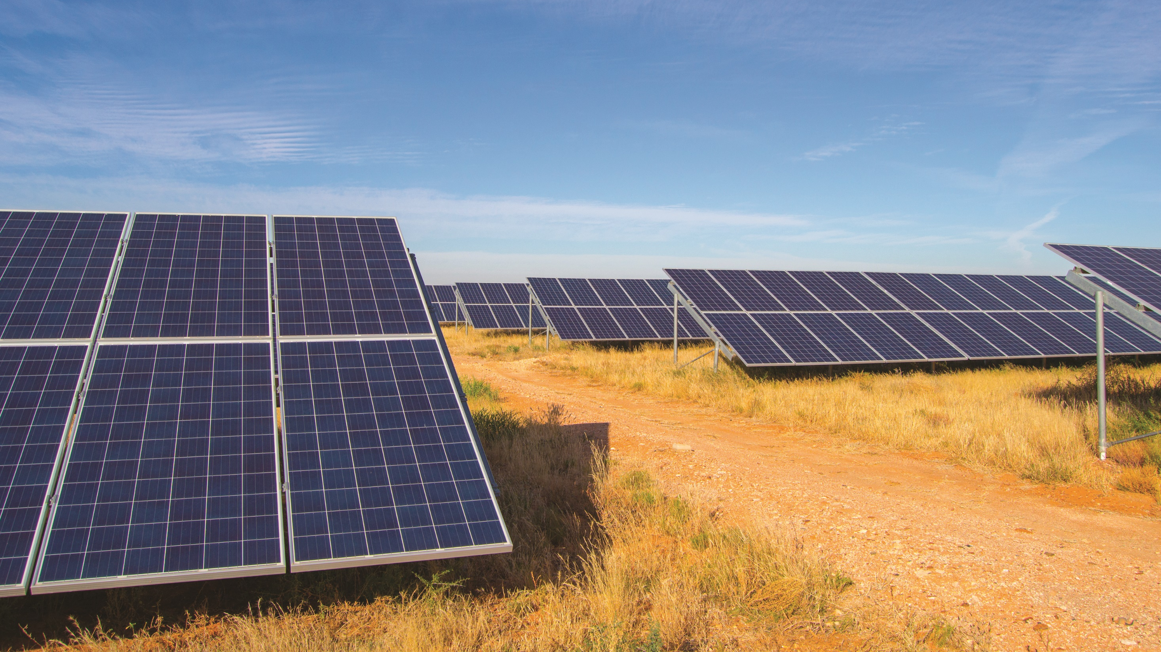
Solar Energy for Smart Village in Ethiopia

Slide 2
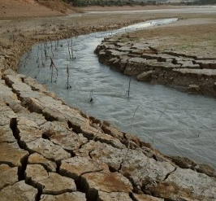
PROBLEM FACED:
Low access to energy;
Climate change;
Food insecurity.
PROJECT AIM:
The project involves the transformation of a rural village through the exploitation of solar energy for:
Improve residential electric access;
Pumping agricultural water for irrigation.

Slide 3
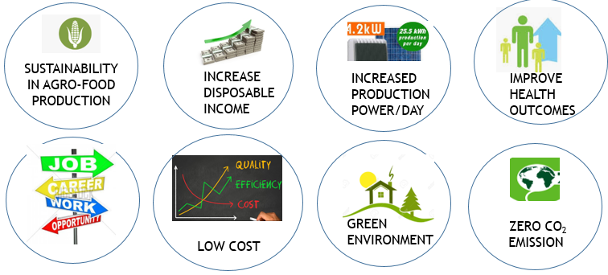
STRATEGIC RELEVANCE
SOLAR ENERGY

Slide 4
OPPORTUNITIES FOR ITALIAN INDUSTRIES
It is possible to identify new business models that combine to:
Off-grid generation facilities with low costs;
Energy-efficient house hold equipment's and solar water pump technologies to potential buyers;
Solar technology building industries;
Standardized technologies for plug-and-play systems that would greatly reduce the complexity and cost of designing and installing a solar-energy system;
The development of the territory and the involvement of industries and communities.

Slide 5
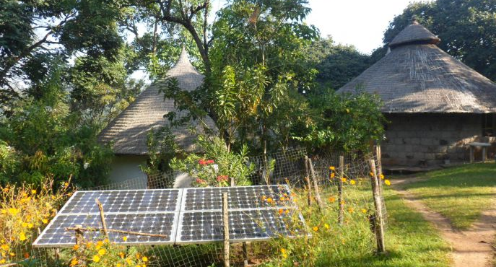
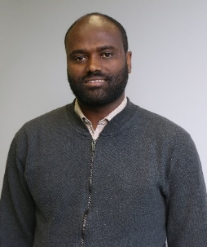
ETHIOPIAN TEAM
Debasu
EYASU
Mekalia
AKLILU
Meron
TEFERA

