Slide 1
Nigeria Next Production Revolution Competence Center (NPRCC)

Slide 2
The Problem: WHERE WE ARE
35% Skills & Digital Literacy
49% Infrastructure
46% Environment
18% Economic Maturity (Siemens)
Huge post-harvest losses – over 60% of farm produce valued at US$9 billion
Loses USD$10 billion in annual export opportunity from groundnut, palm oil, cocoa and cotton
64% Lack Electricity in Rural Areas (RMI)
90% Dependence on
Road Transport

Slide 3
The Solution: NPRCC
Government
Academia
Industry
Startups
Communities
NEXT PRODUCTION REVOLUTION COMPETENCE CENTRE (NPRCC)
ENERGY
MOBILITY
DIGITALISATION
ENERGY
MOBILITY
DIGITALISATION

Slide 4
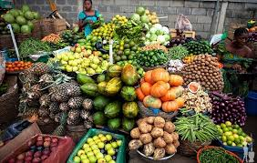
NPRCC and the Food Industry
WORLD NO 1
cassava (50 million metric tonnes)
yams (44.1 million tonnes)
WORLD NO 2
cashews (960,000 tonnes)
ginger (522,000 tonnes)
AFRICA’S NO 1
rice (4 million tonnes)
maize (12 million tonnes)
GOVERNMENT INITIATIVES
Anchor Borrowers’ Programme
Commercial Agriculture Credit Scheme (CACS)
Nigeria Incentive-Based Risk Sharing System for Agricultural Lending (NIRSAL)
US$ 500 million (NGN 200 billion) Special Credit Intervention Fund

Slide 5
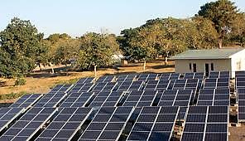
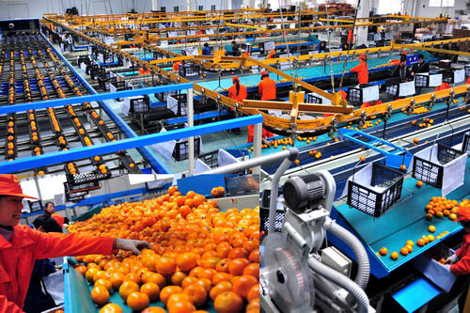
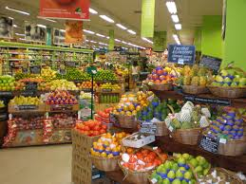
Opportunity for Italian industries
Mini-Grid for Agric. & Social
Agric. Tech: Machines & Processing
Commerce & Scale-up
Renewable Energy for Power Generation
Energy Efficiency
Energy Efficiency
Digitization
Mobility
Block-Chain Technology
Digitization

Slide 6
Team Nigeria
Blessing Onyeche UGWOKE
Femi OYE
Donald UMUNNA
Obindah GERSHON
Suzanne MYADA

