Slide 1
Smart ecosystem for technology
and knowledge growth in manufacturing
The Online Knowledge Transfer Platform

Slide 2
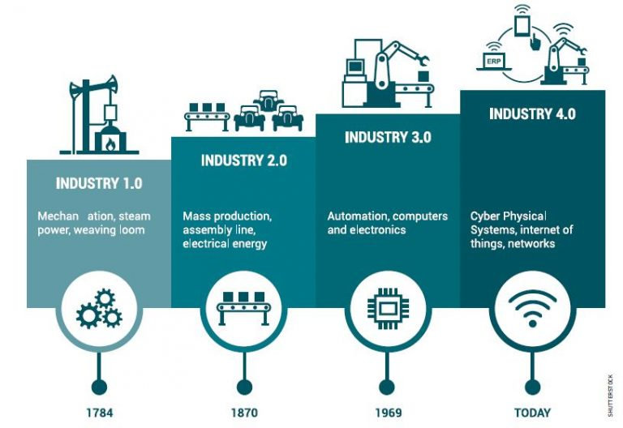
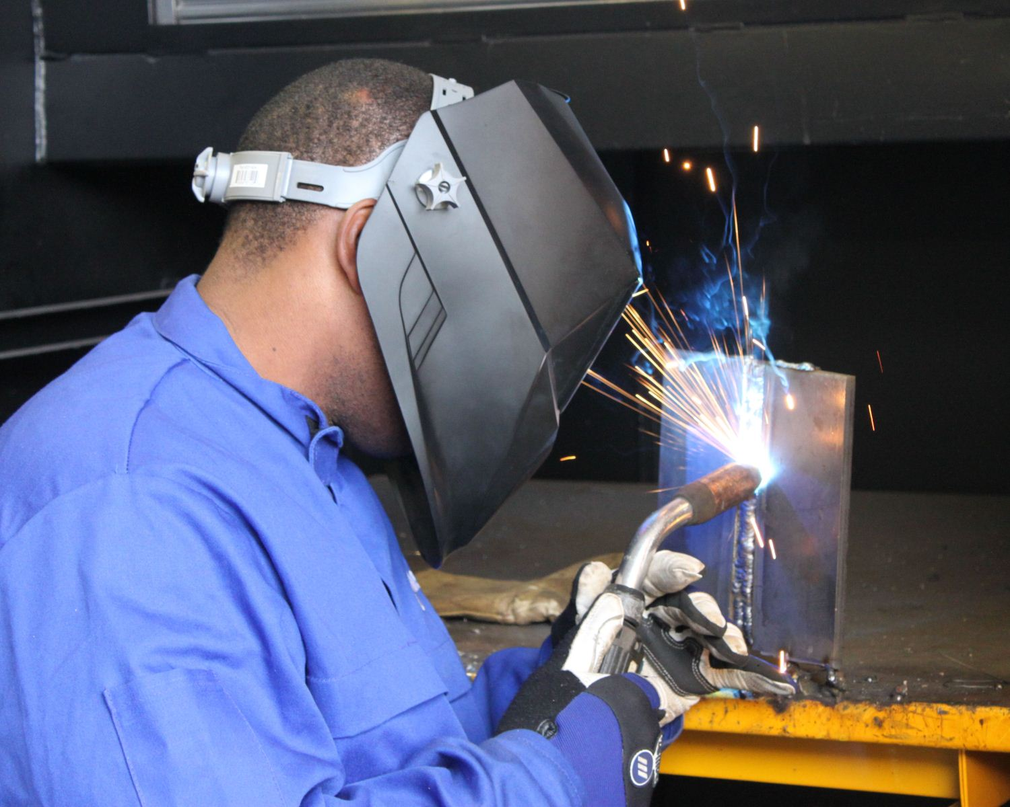
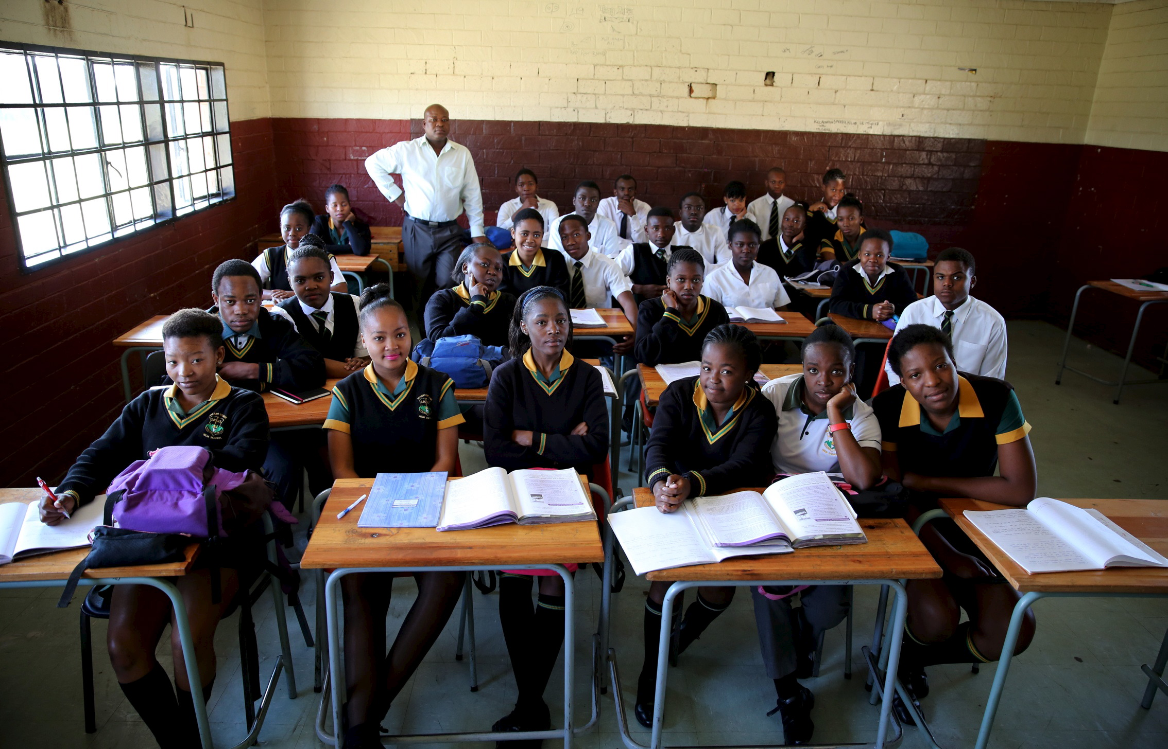
Smart ecosystem for technology and knowledge growth
- Mozambique
Developed Countries
Mozambique
Underdeveloped Education System
Unskilled Labour
Inequality
Unemployability
GAP
Project aim:
Expand access to internet services
Raise awareness and educate talents and professionals about the technology megatrends
Innovative knowledge transfer methods and collaboration.

Slide 3
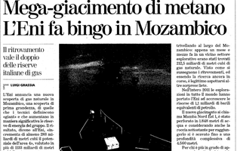
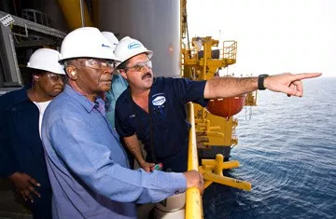
Strategic relevance
Smart ecosystem for technology and knowledge growth
- Mozambique
The recent gas discoveries on the shores of the Rovuma basin represent an important opportunity to relieve Mozambicans from poverty in the near future.
To achieve this goal, the Mozambicans must be technically prepared to become one modern highly skilled workforce.
This process begins by attracting young talents at secondary school level, introducing them to science courses, technology, engineering and mathematics (STEM) since young and continues with dedicated support in universities and the post-university level.
Secondary Schools
Local Manufacturing Industry
Community
Agribusiness
Health Facilities
Universities

Slide 4
Opportunity for Italian industries
Smart ecosystem for technology and knowledge growth
- Mozambique
Potential Financial Sponsors: Govt of Mozambique; Italian Agency for Development Cooperation; European Union; UNIDO; Fondazione Eni Enrico Mattei; GE Italia; others.
Value: To contribute financially to the project
Technical Sponsors: Fondazione Eni Enrico Mattei; GE Italia; Deloitte; Politecnico di Milano; METID; Politecnico di Torino; Universidade Eduardo Mondlane; Universidade São Tomas de Mocambique, Consortium GARR and others.
Value: To contribute by transferring knowledge and technology to our target groups.
Knowledge Transfer for local manufacturing industry
MOOCs
Thematic Workshops
Knowledge transfer for universities
MOOCs
Thematic Workshops
Knowledge transfer for secondary schools and communities
MOOCs
Thematic Workshops

Slide 5
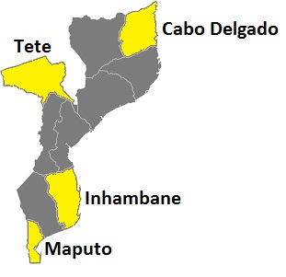
Potential Impact
Smart ecosystem for technology and knowledge growth
- Mozambique
Cabo Delgado
Secondary Schools: 37
TVET: 8
Students: 56,000
Hospitals: 123
CMC: 5
Agricultural Centres: TBD
Capital | Maputo
Population | 29.6 million
Men | 48%
Women | 52%
Urban | 32%
Rural | 68%
Official Language | Portuguese
GDP per capita | ± 450 USD
Households with access to Electricity | 7.8 million (28%)
Households with access to internet | 10.8%
Individuals using internet | 20.8%
Tete
Secondary Schools: 68
TVET: 15
Students: 92,000
Hospitals: 130
CMC: 5
Agricultural Centres: TBD
Inhambane
Secondary Schools: 78
TVET: 18
Students: 112,000
Hospitals: 145
CMC: 5
Agricultural Centres: TBD
Maputo
Secondary Schools: 98
TVET: 31
Students: 168,000
Hospitals: 292
CMC: 5
Agricultural Centres: TBD

Slide 6
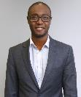
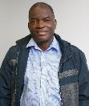
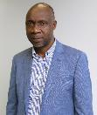
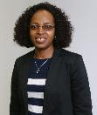
Team Mozambique
Claudio
BUQUE
Fernando LICHUCHA
Lourino CHEMANE
Lucia GINGER

